Slide 1
Dr. Sunirmal Khatua
Inter Process Communication (IPC):
Socket, RMI and Web Services
By
Visvesvaraya Young Faculty Fellow, Govt. of India
Assistant Professor, University of Calcutta
Notes:
We celebrate Christmas to remember the birth of Jesus Christ

Slide 2


Interprocess Communication
A Distributed System is a Collection of SMALL independent computers that appears to its users as a single BIG coherent system.
Properties of Distributed Algorithm:
Multiple Processes
Interprocess Communication
Disjoint Address Spaces
Collective Goal
Socket
S
C
The Gulliver’s Travel

Slide 3
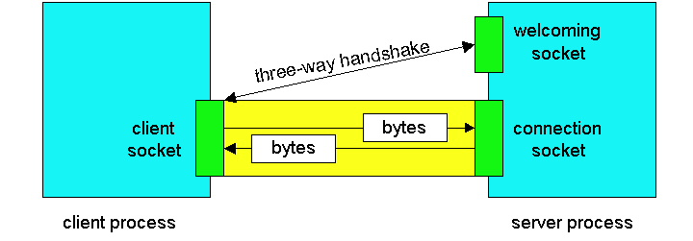
Socket based IPC in Java
public class TCPServer {
public static void main(String args[]) throws Exception{
String receivedMsg, returnMsg;
ServerSocket welcomeSocket = new ServerSocket(4444);
while(true){
Socket connSocket = welcomeSocket.accept();
Scanner inFromClient = new Scanner(connSocket.getInputStream());
OutputStream outToClient = connSocket.getOutputStream();
receivedMsg = inFromClient.readLine();
returnMsg = receivedMsg.toUpperCase();
outToClient.write((returnMsg +”\n”).getBytes());
connSocket.close();
}}}
public class TCPClient {
public static void main(String args[]) throws Exception{
String sendMsg, receivedMsg;
Scanner inFromUser = new Scanner(System.in);
sendMsg= inFromUser.readLine();
Socket clientSocket = new Socket(“localhost",4444);
OutputStream outToServer = clientSocket.getOutputStream();
Scanner inFromServer = new Scanner(clientSocket.getInputStream());
outToServer.write((sendMsg+"\n“).getBytes());
receivedMsg= inFromServer.readLine();
System.out.println("FROM SERVER : "+receivedMsg);
clientSocket.close();
}}

Slide 4
Interprocess Communication
A Distributed System is a Collection of SMALL independent computers that appears to its users as a single BIG coherent system.
Properties of Distributed Algorithm:
Multiple Processes
Interprocess Communication
Disjoint Address Spaces
Collective Goal
Socket
S
C
ret = Procedure(param)
Java RMI (Remote Method Invocation)
The Gulliver’s Travel

Slide 5
Transparency in RMI
MyName
Naming Service
OtherName
obref = lookup(“MyName”)
---
ret = obref.method1(“param”)
Lookup for MyName
Register with MyName
Registry ns = LocateRegistry.createRegistry(80)
ns.bind(“name”, obref)
Client
Server
Create
Registry ns = LocateRegistry.getRegistry(“127.0.0.1”,80)
obref = ns.lookup(“name”)
Remote Object

Slide 6
Steps in RMI
Step 1: Define Remote Interface
public interface AddIntf extends Remote {
public int add(int i, int j) throws RemoteException;
}
Step 2: Implement the Remote Interface
public class AddImpl extends UnicastRemoteObject implements AddIntf {
public int add(int I, int j) throws RemoteException {
return i+j;
}
}
Step 4 : Define the Client
public class AddClient {
public static void main(String args[]) throws Exception {
Registry ns = LocateRegistry.getRegistry(“localhost”, 1099);
Addntf obref = (Addntf) ns.lookup(“add”);
int k = obref.add(30,50);
System.out.println(“30+50=”+k);
}
}
Step 3 : Define the Server
public class AddServer {
public static void main(String args[]) throws Exception {
AddImpl obj = new AddImpl();
Registry ns = LocateRegistry.createRegistry(1099);
ns.rebind(“add", obj);
System.out.println(“Server Ready…….”);
}
}

Slide 7
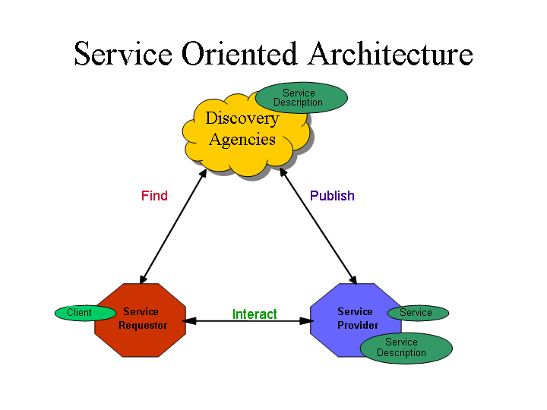
What are Web Services?
Web Service is an efficient way of implementing inter process communication running at a higher level.
Web Service is a set of remote methods accessible via web (HTTP protocols)
It is the convergence of the following 2 technologies
1. The Web
Universal Communication
HTTP, XML
2. Service Oriented Computing
Expose data and business logic through a programmable interface
RPC, RMI, CORBA, DCOM
There are 2 types of Web Services
REST (Representational State Transfer)
Uses Standard HTTP methods (GET, POST, PUT, DELETE)
Support both JSON and XML
Used in light weight applications
SOAP (Simple Object Access Protocol)
Uses XML based messaging
Operates over HTTP, SMTP, TCP
Used in highly secured applications
Server
Code
Server Code
WSDL
WSDL
UDDI
Optional
SOAP/REST
Request
WSDL
Client
Client Code
Generate

Slide 8
Simple Object Access Protocol (SOAP)
SOAP is a technology to support the exchange of XML-coded messages over a transport protocol, such as HTTP and SMTP.
HTTP
SOAP Envelope
<soap:Envelope> <soap:Header> <axis:SessionKey> SDHH37TYEW7R7 </axis:SessionKey> </soap:Header> <soap:Body> <GetPrice> <Item>Apples</Item> </GetPrice> </soap:Body> </soap:Envelope>
SOAP
SOAP Header
XML
Session, Authentication, Routing, Security
Communication Info
SOAP Body
Protocols Folding
XML Document
Client
Server
  XML
XML  
ClockService.getTime(location="USA");
Stub
Skeleton
  SOAP
SOAP  
<soap:Body> <getTime> <location xsi:type="xsd:string">USA</location> </getTime> </soap:Body>
POST…
HTTP client
HTTP server
HTTP 1.1 200 OK
SOAP basic mechanism

Slide 9
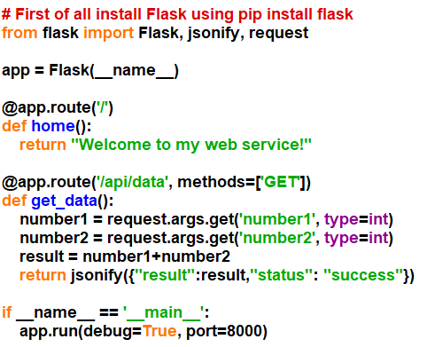

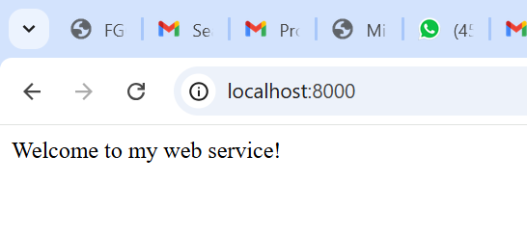
Building a RESTfull Web Service in Python using Flask

Slide 10
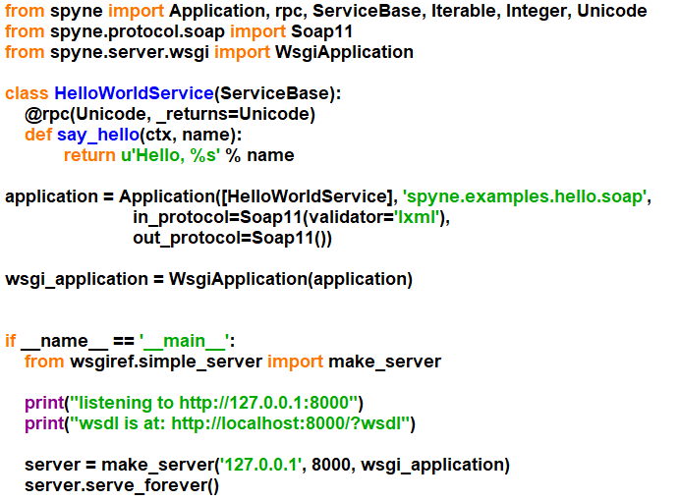
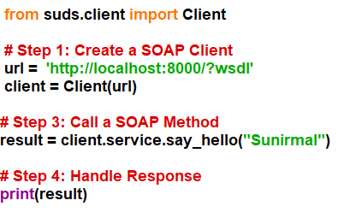
Building a SOAP Web Service in Python using spyne and suds

Slide 11
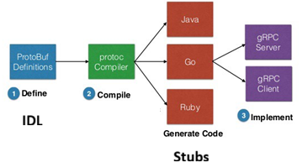
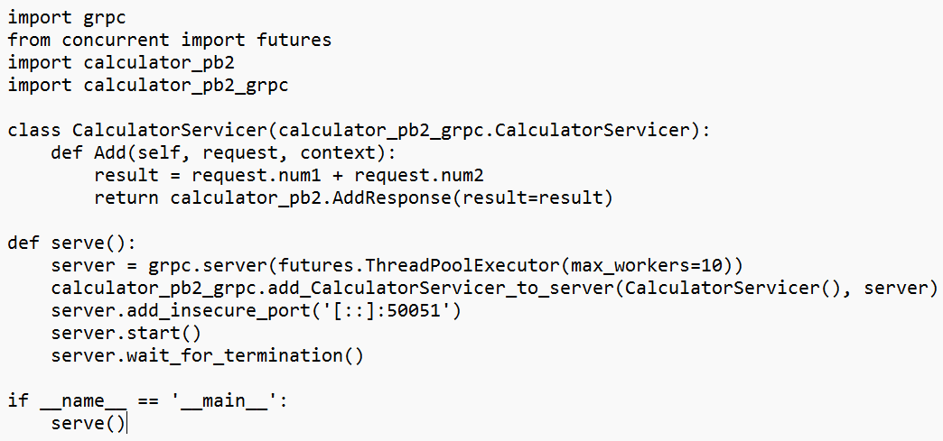
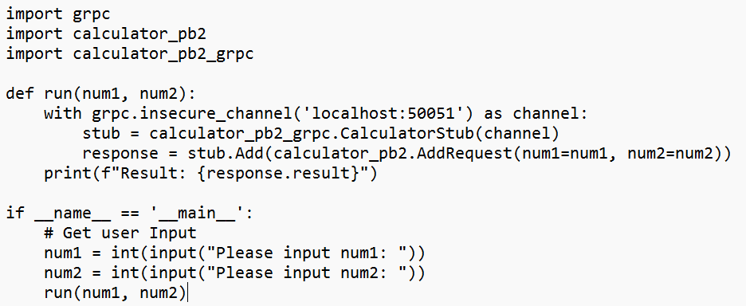
gRPC Framework
RPC Framework developed by Google for cross platform RPC invocation.
Server Side
Client Side

Slide 12
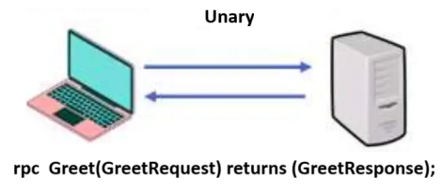
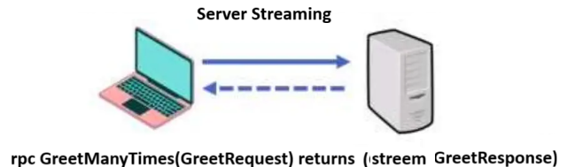
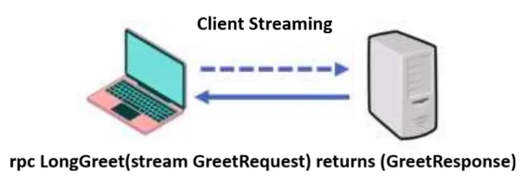
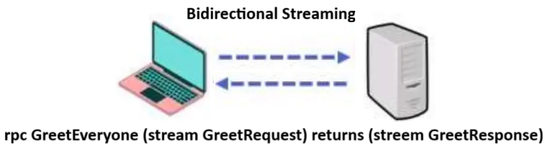
Types of gRPC API

Slide 13
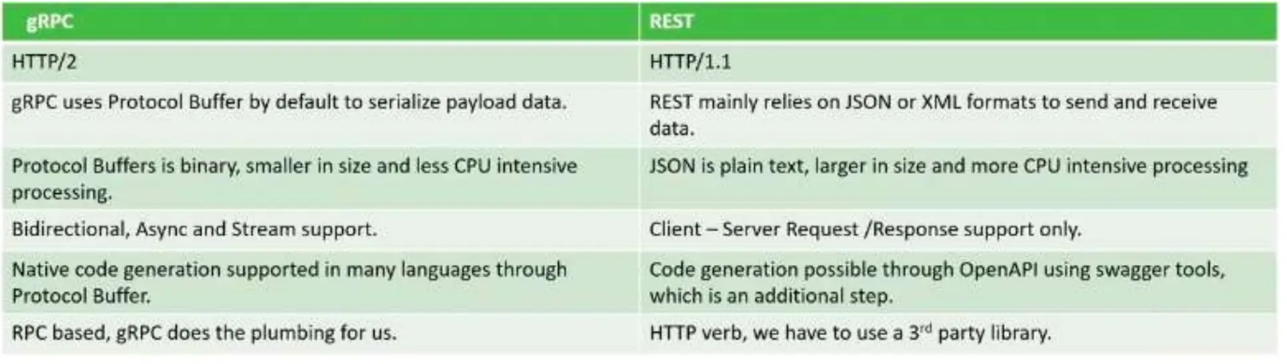
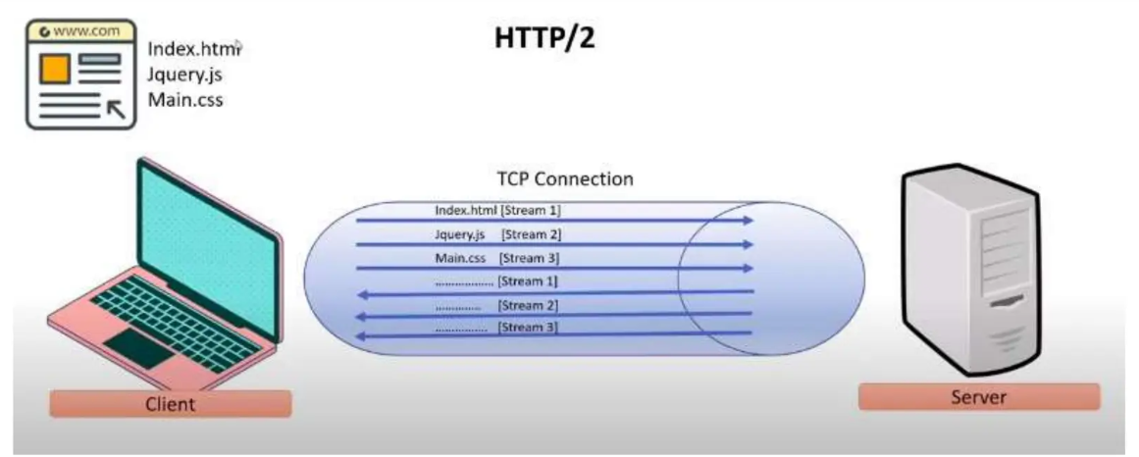
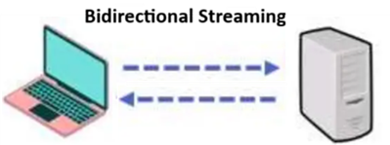
RESTful API vs gRPC API

Slide 14
Questions?
Thank You

